Slide 1
Image Processing with Python
The Uplift Project

Slide 2
Contents
1
Introduction to Image Processing
2
Key Stages in IP
3
Applications of Image Processing

Slide 3
What is an image?
An image is an artifact that depicts visual perception

Slide 4
Image representation in computer world.
To store an image on a computer, the image is broken down into tiny elements called pixels. A pixel (short for picture element) represents one colour.
Each pixel is stored as an integer value
An Image is stored as a matrix of values in the computer.

Slide 5
Types of Image Representations
Binary - 0 and 1
Grayscale - Represents the intensity of light from 0 to 255.
Color Image - RGB (0,0,0)

Slide 6
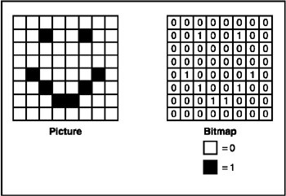
Binary Image

Slide 7
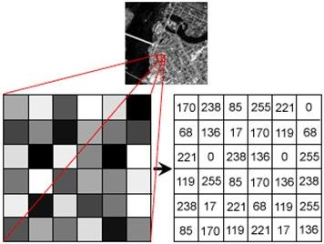
Grayscale Image

Slide 8
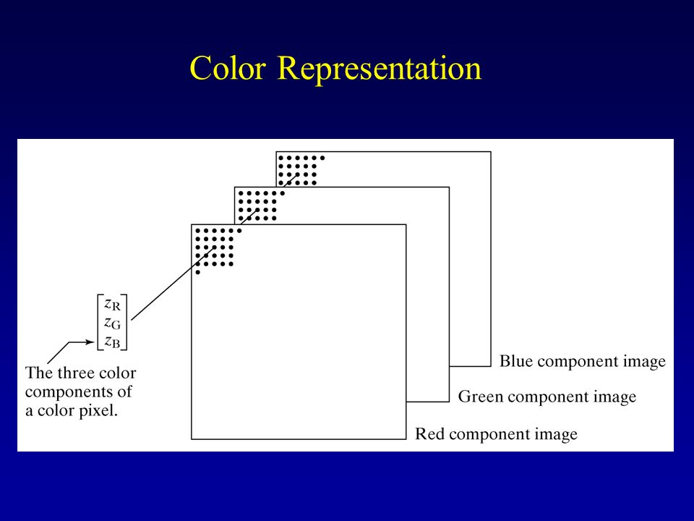
Color Image

Slide 9
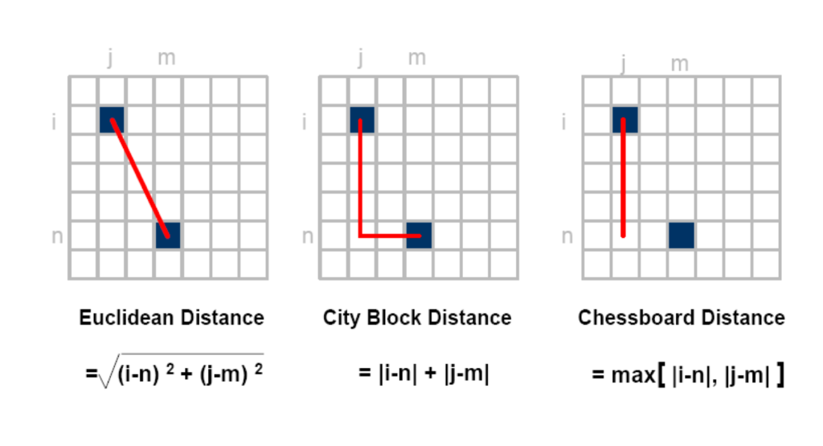
Distance Measure

Slide 10
What is Image Processing?
Improvement of Pictorial Information for better human interpretation.
Processing of image data for storage, transmission and
representation for autonomous machine perception

Slide 11
Key Stages in Image Processing
Image Acquisition
Image Enhancement
Image Restoration
Object Recognition
Representation and Description
Image Compression

Slide 12
Applications of Image Processing
Document Handling
Object Recognition
Satellite Imagery
Traffic Monitoring
Number Plate Identification
Face Detection

Slide 13
Introduction to OpenCV in Python
OpenCV is a cross-platform library using which we can develop real-time computer vision applications. It mainly focuses on image processing, video capture and analysis including features like face detection and object detection.

Slide 14
Basic Operations
Your image should be in the same folder as your code else you will have to access that image using a path!
Read - imread()
Write - imwrite()
Show - imshow()
But first you need to import cv2

Slide 15
CODE

Slide 16
References
https://opencv-python-tutroals.readthedocs.io/en/latest/py_tutorials/py_tutorials.html

